Slide 1

PROGRAMMING FUNDAMENTALS
FALL 2023

Slide 2

WEEK 7

Slide 3
Ternary operator
? :
(condition) ? Incase its satisfied : in case it isn’t satisfied ;

Slide 4
Can it be nested ?
yes

Slide 5
Home task
Try writing multiple conditions using logical operators in ternary operator

Slide 6
Switch statement
When it does not works ?
When does it works ?

Slide 7
Break in a switch
break ;

Slide 8
Nested switch
Yes can be done , even with else if , if ……both within each other .

Slide 9
Home task
Practice switch in switch
Switch in else if
else if in switch case , call function in case
And so on…
Try switch on float and see what happens ?

Slide 10
If else vs ternary
https://stackoverflow.com/questions/3565368/ternary-operator-vs-if-else and https://stackoverflow.com/questions/6754454/speed-difference-between-if-else-and-ternary-operator-in-c
No need to memorize ,but understand , go through the links don’t ignore.

Slide 11
Code already shared on gcr

Slide 12
WEEK 7(LEC 14)

Slide 13

Switch or else if ?
A case where switch actually gives you a performance advantage is if the variable part is a function call:
switch(some_func()) {
case 1: ... break;
case 2: ... break;
}
Then some_func() is only called once while with
if(some_func() == 1) {}
elseif(some_func() == 2) {}

Slide 14
Pre fix and post fix
x++ or ++x ?
Yes there is difference

Slide 15
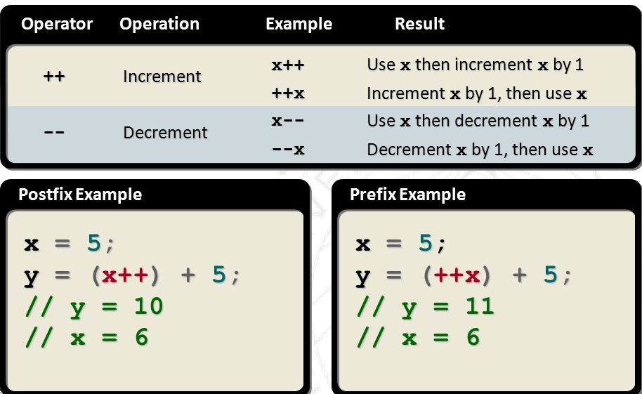

Slide 16
Code already shared on gcr

Slide 17
iterations
Loops
For
While
Do while

Slide 18
for(int i=0; i<11;i++)
{
printf(“%d\n”,i);
}

Slide 19
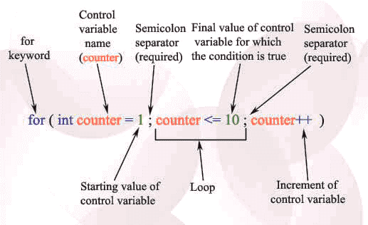

Slide 20

Name :_____
Quiz :_____
Bring A4 pages in every class from now onward , we can have quiz /quizzes any time.
If quizzes are attempted on any other page than A4 white page , direct zero will be awarded.

Slide 21




THANK YOU

